Slide 1


Data Visualization
25-February-2020
Sepi Chakaveh & Assel Altayeva
Overview Data Science

Slide 2
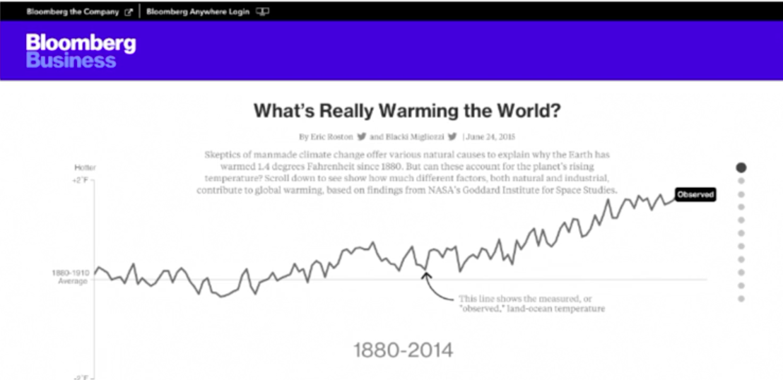
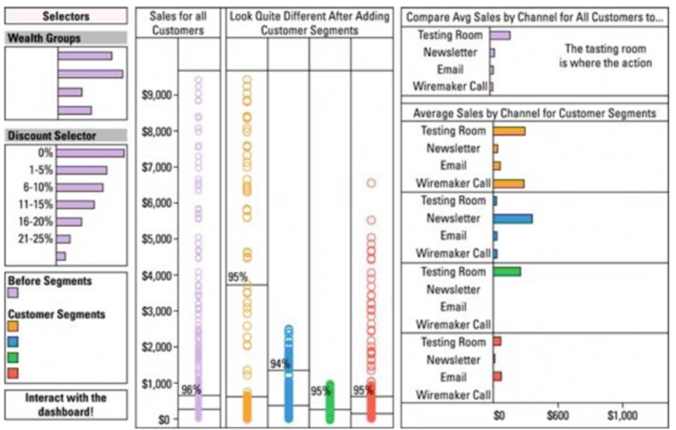
Three data visualization types
Data storytelling – for presentations to
organisational decision makers
- Clutter free, highly organised
Data showcasing – for presentations to analysts, mathematicians, scientists and engineers
Highly contextual, open ended
Data art - for presentations to general public or activists
- Attention getting

Slide 3
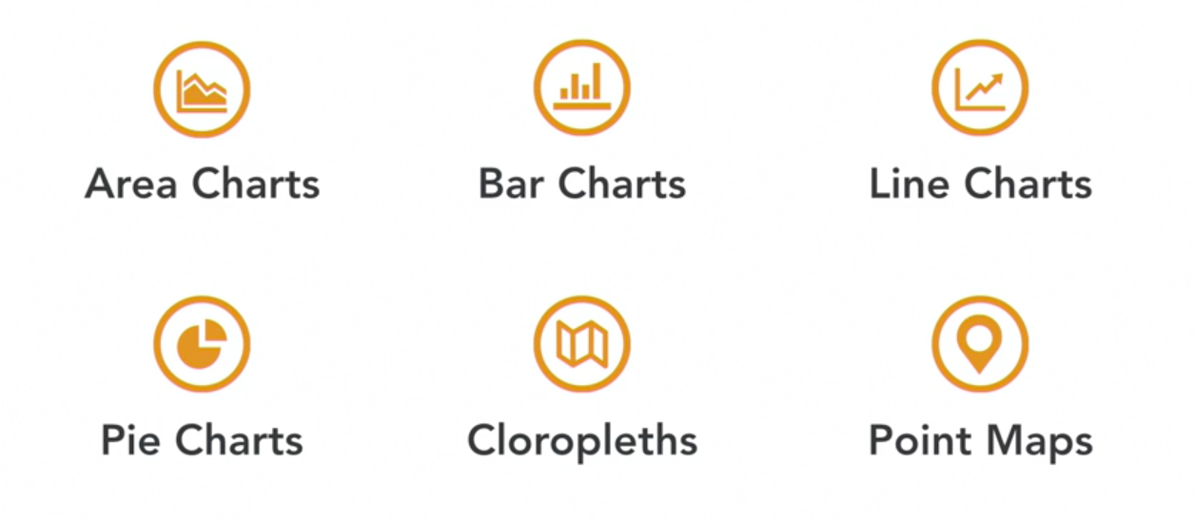
Choosing graphics for Data storyteling

Slide 4
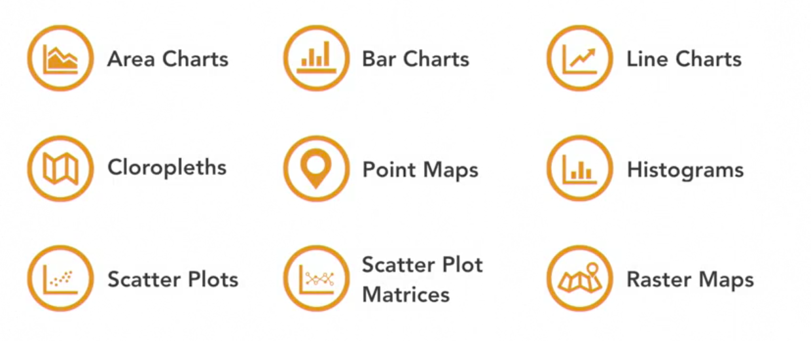
Graphics for Data showcasing

Slide 5
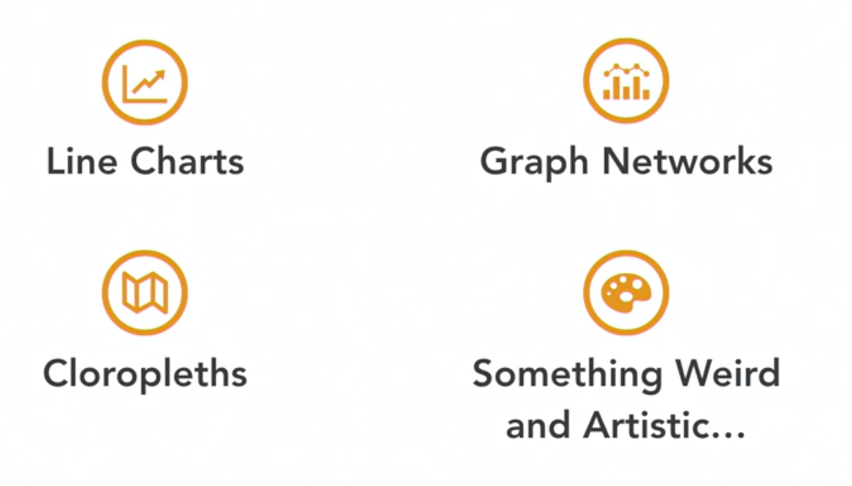
Graphics for Data art

Slide 6
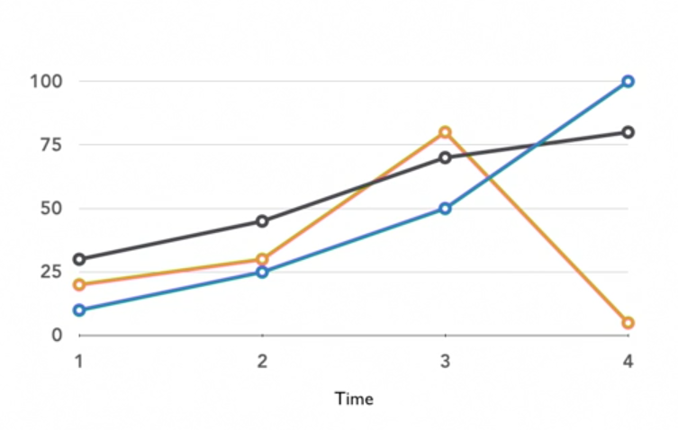
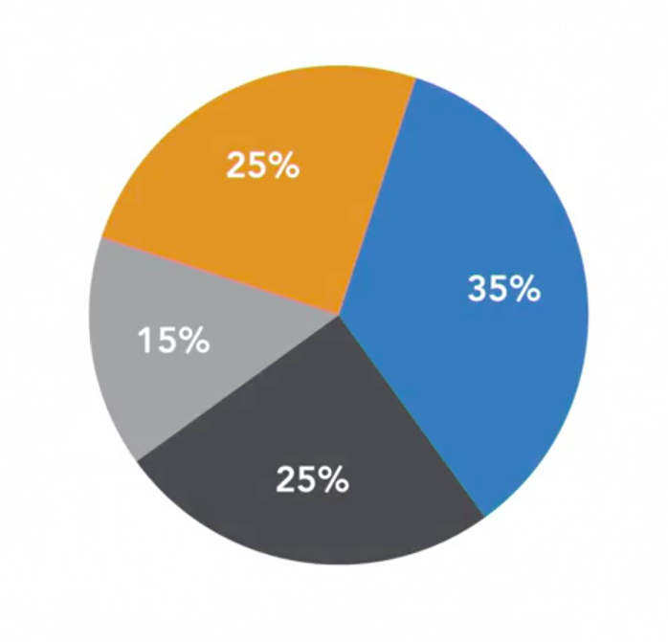
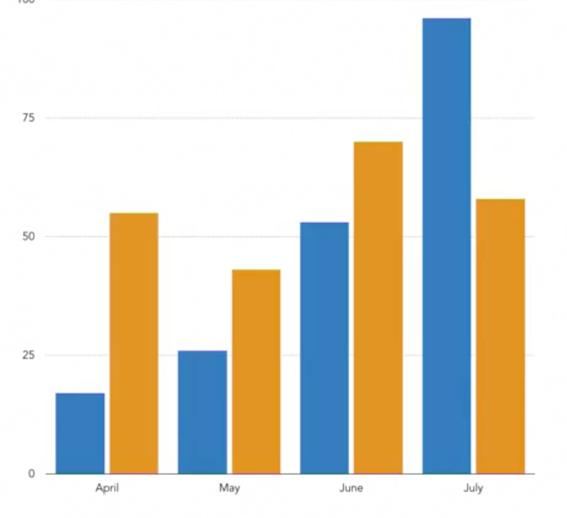
Creating standard charts
Line charts
Pie charts
Bar charts

Slide 7
Plot building
Two methods:
Functional - calling the plotting function on a variable or a set of variables.
Object-oriented - build a plot by first generating a blank figure object and then populating that object with plot and plot element.
Popular Python Libraries:
Matplotlib
-is a 2D plotting library for Python
- it produces publication
- quality figures in different hardcopy formats.
Seaborn

Slide 8
Defining plot elements with Matplotlib
Plot elements add context to your plot, so that the plot effectively conveys meaning to its viewers.
Adding plot elements is an essential part of object-oriented plotting:
1. Create a blank figure object.
2. Add axes to the figure.
3. Generate a plot(s) within the figure object.
4. Specify plotting and layout parameters for the plots within your figure.

Slide 9
Matplotlib
[]. from matplotlib import pyplot as plt
plt.plot([1,2,3],[4,5,1])
plt.show()
plt.plot([1,2,3],[4,5,1],'r--’)
lt.show()
plt.plot([1,2,3],[4,5,1],'g*-’)
plt.show()

Slide 10
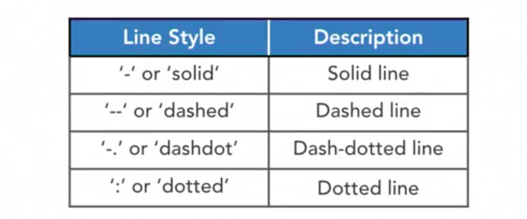
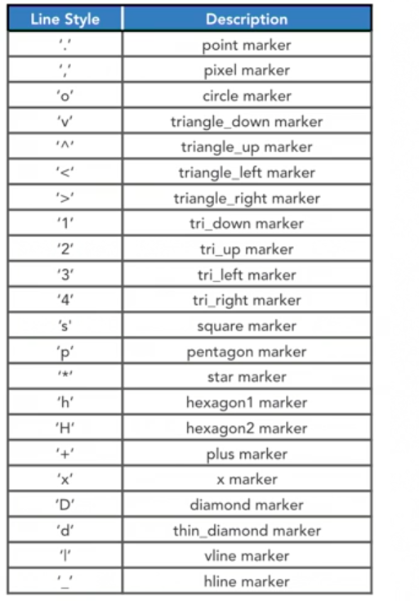
Plot formatting
Plot color
Customizing line styles
Line style argument ls=‘solid’
Setting marker styles
marker = ‘star marker’
Documentation https://matplotlib.org

Slide 11
Labels and annotations
Labelling plot feature
Adding a legend to your plot
.legend(plot, loc)
Annotating your plot
.annotate(xy, xytext, arrowprop)
xy = the location being annotated
xytext = the location of the text
arrowprop draws an arrow from the text to the annotated point

Slide 12
Example
from matplotlib import pyplot as plt
x = [5,2,7] y = [2,16,4]
plt.plot(x,y)
plt.title('Info’)
plt.ylabel('Y axis’)
plt.xlabel('X axis’)
plt.show()

Slide 13
Example
from matplotlib import pyplot as plt
plt.bar([0.25,1.25,2.25,3.25,4.25],[50,40,70,80,20], label="BMW",width=.5)
plt.bar([.75,1.75,2.75,3.75,4.75],[80,20,20,50,60], label="Audi", color='r',width=.5)
plt.legend()
plt.xlabel('Days’)
plt.ylabel('Distance (kms)’)
plt.title('Information’)
plt.show()

Slide 14
Example
import matplotlib.pyplot as plt x = [1,1.5,2,2.5,3,3.5,3.6] y = [7.5,8,8.5,9,9.5,10,10.5]
x1=[8,8.5,9,9.5,10,10.5,11]
y1=[3,3.5,3.7,4,4.5,5,5.2]
plt.scatter(x,y, label='high income low saving',color='r’)
plt.scatter(x1,y1,label='low income high savings',color='b’)
plt.xlabel('saving*100’)
plt.ylabel('income*1000')
plt.title('Scatter Plot’)
plt.legend()
plt.show()

Slide 15
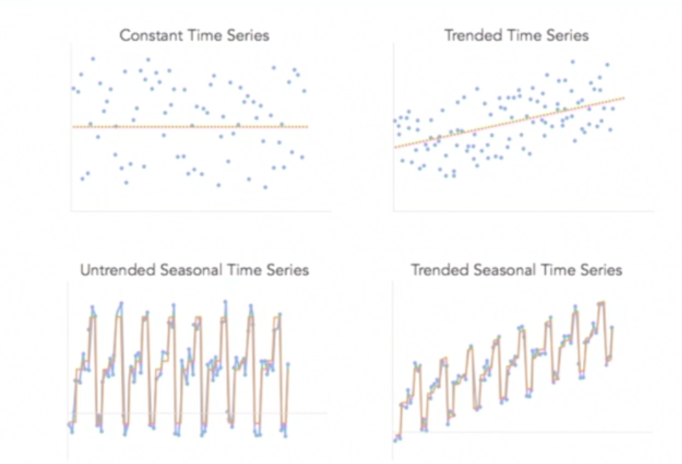
Visualizing Time Series
A time series is a measure of unit change over time for any variable under observation.
The built-in Python datetime module supplies classes for manipulating date and times.

Slide 16
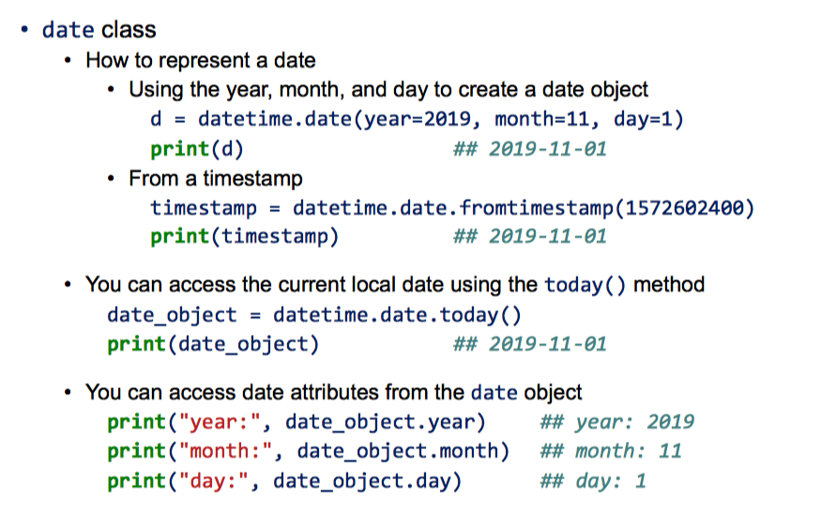
Datetime module

Slide 17
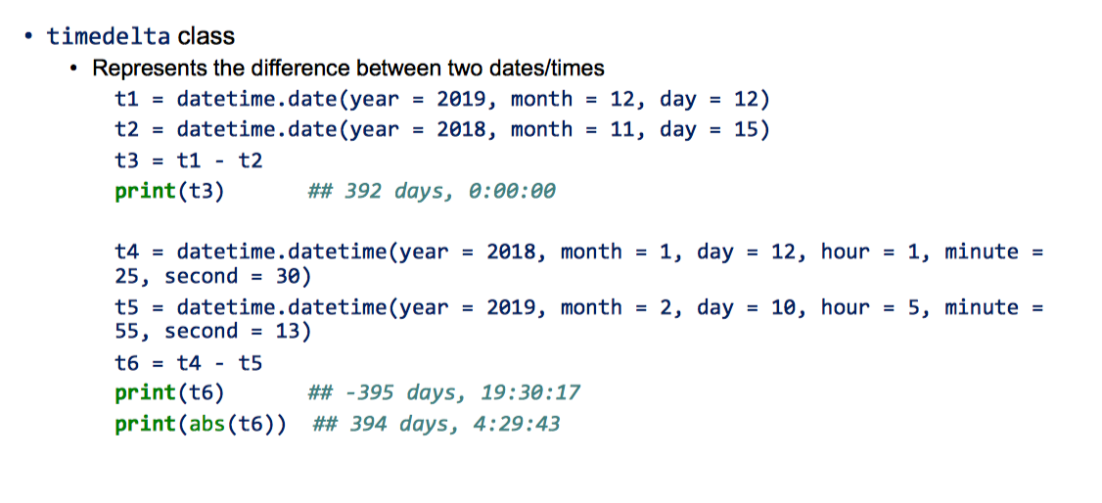
Timedelta module

Slide 18
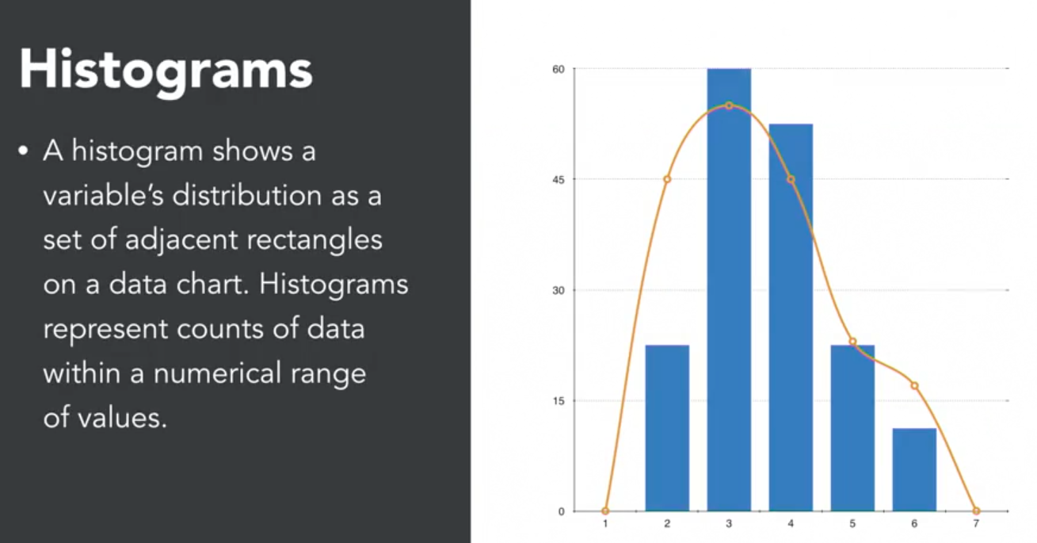
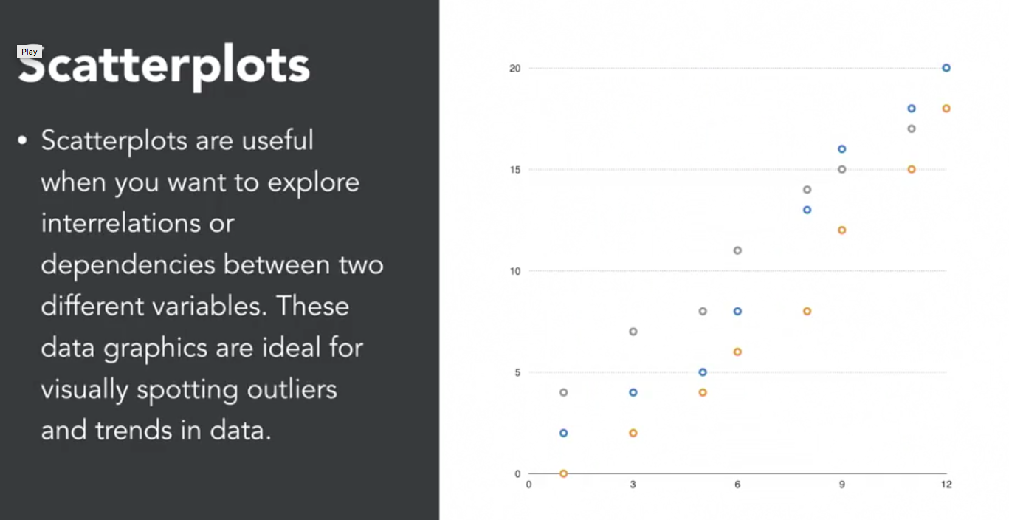
Statistical Plots
Identify outliers
Visualize distributions
Deduce variable type
Discover relationships
and core relations between
variables in a dataset

Slide 19
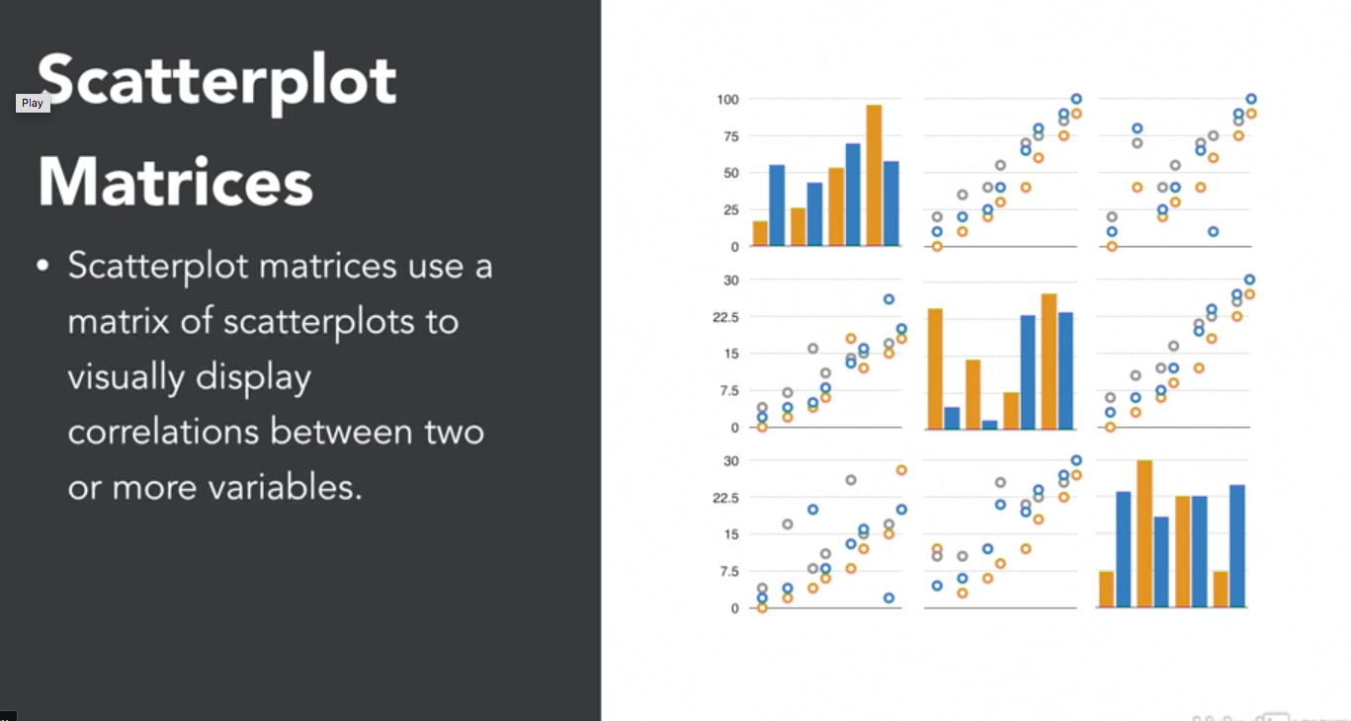
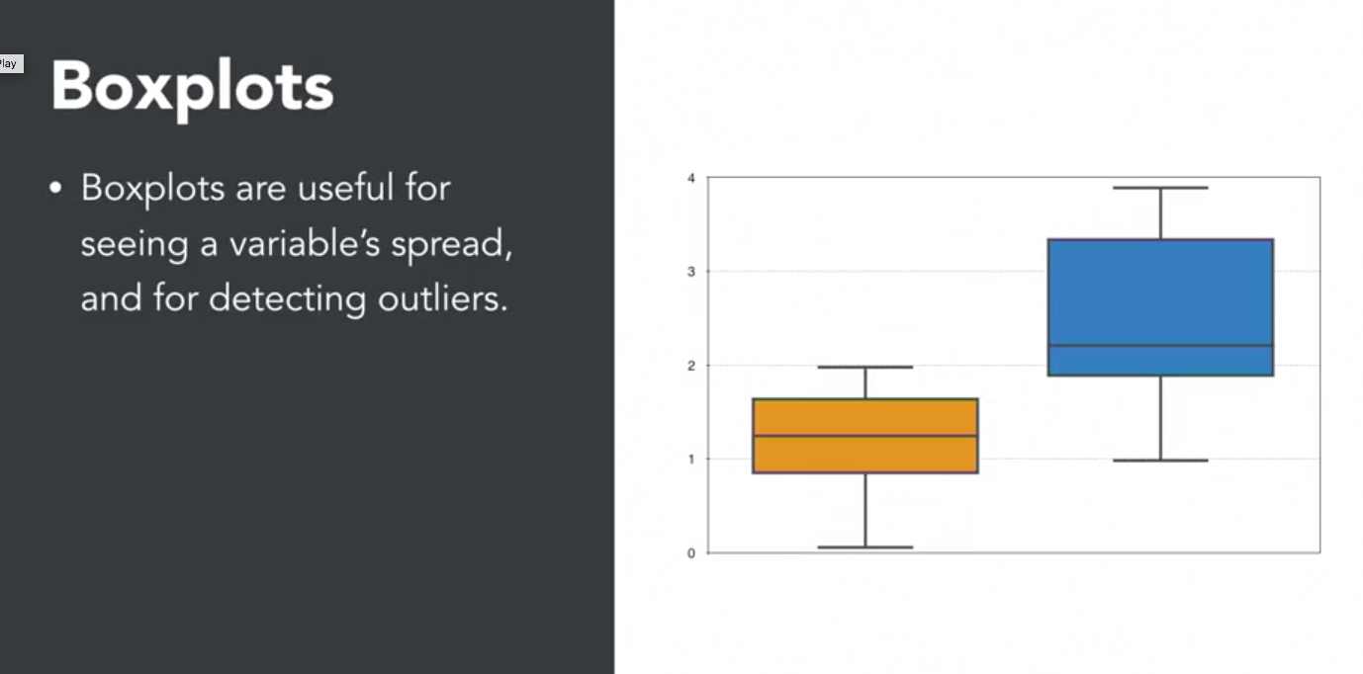
Statistical Plots

